Slide 1
What is a group?

Slide 2
What are we talking about when we use the word group?
For our purposes a group consists of a small collection of people who interact with each other, usually face to face, over time in order to reach goals.

Slide 3
Without interaction, a collection of people isn’t a group.

Slide 4
Interdependence
In groups, members don’t just interact: Their members are interdependent. The behavior of one person affects all the others in what can be called a “ripple effect.”
Consider your own experience in family and work groups: When one member behaves poorly, his or her actions shape the way the entire group functions.
The ripple effect can be positive as well as negative: Beneficial actions by some
members help everyone.

Slide 5


Slide 6
GOALS OF GROUPS AND THEIR MEMBERS
We can talk about two types of goals when we examine groups. The first type involves individual goals—the motives of individual members—whereas the second involves group goals—the outcome the group seeks to accomplish.

Slide 7
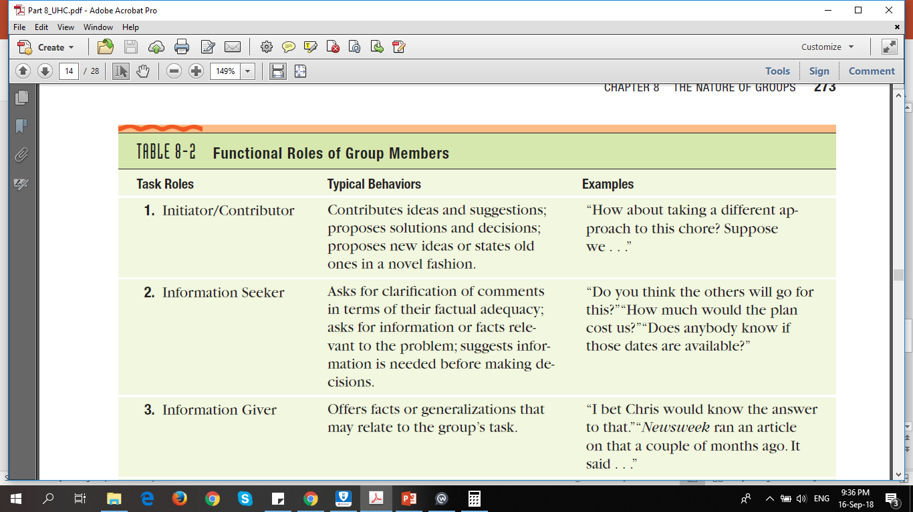

Slide 8
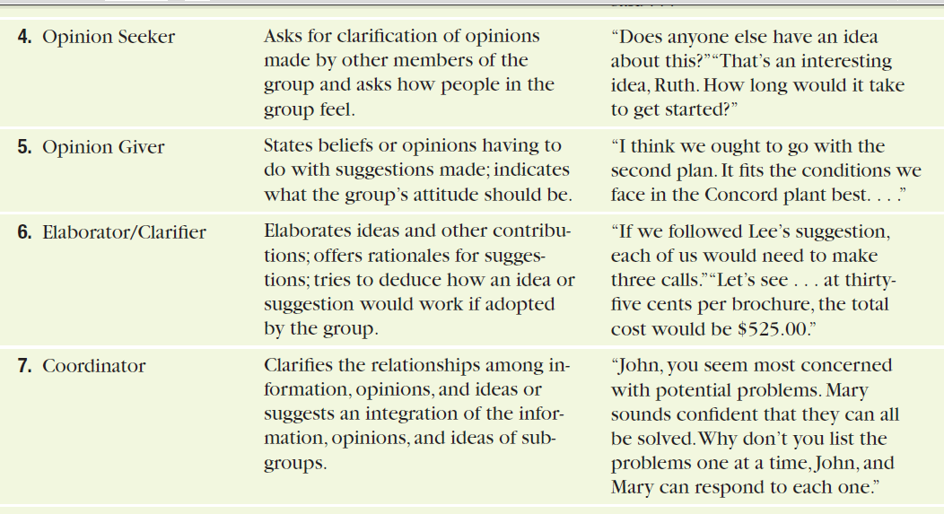

Slide 9
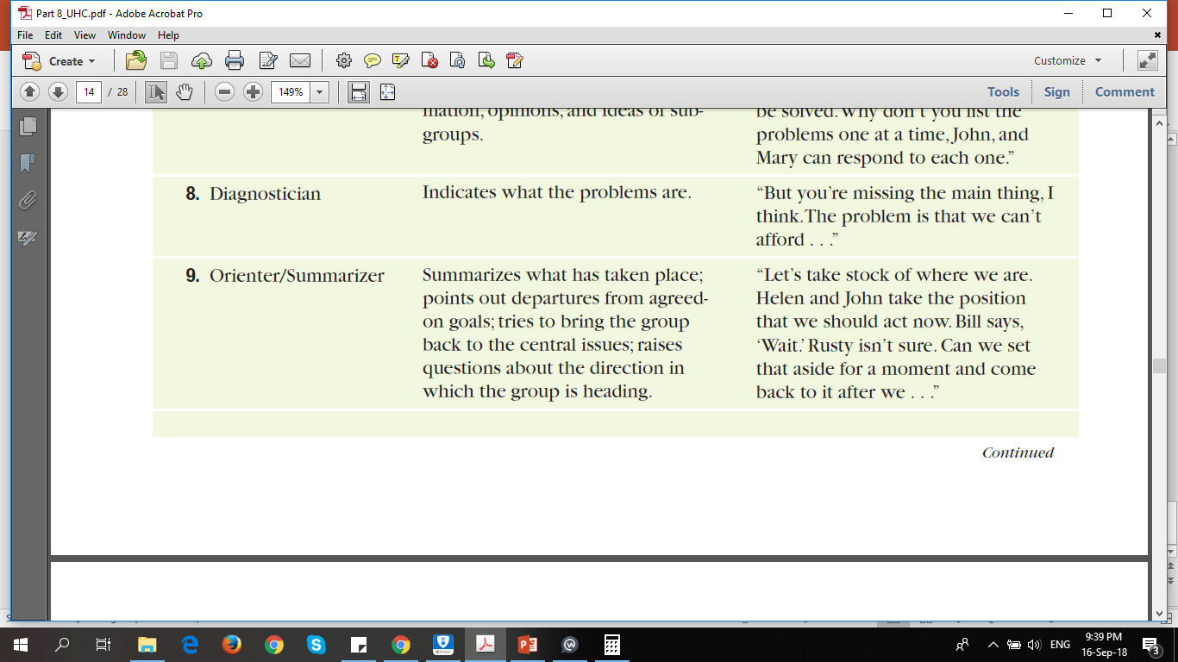

Slide 10
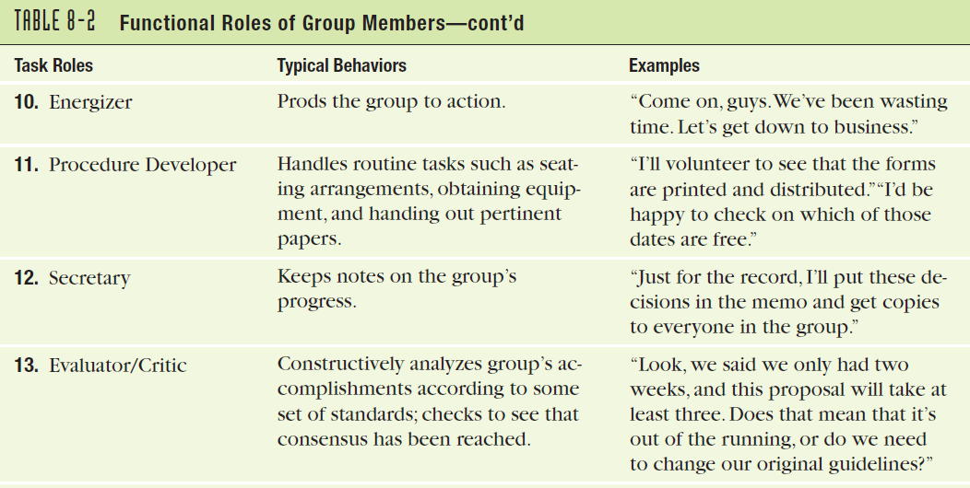

Slide 11
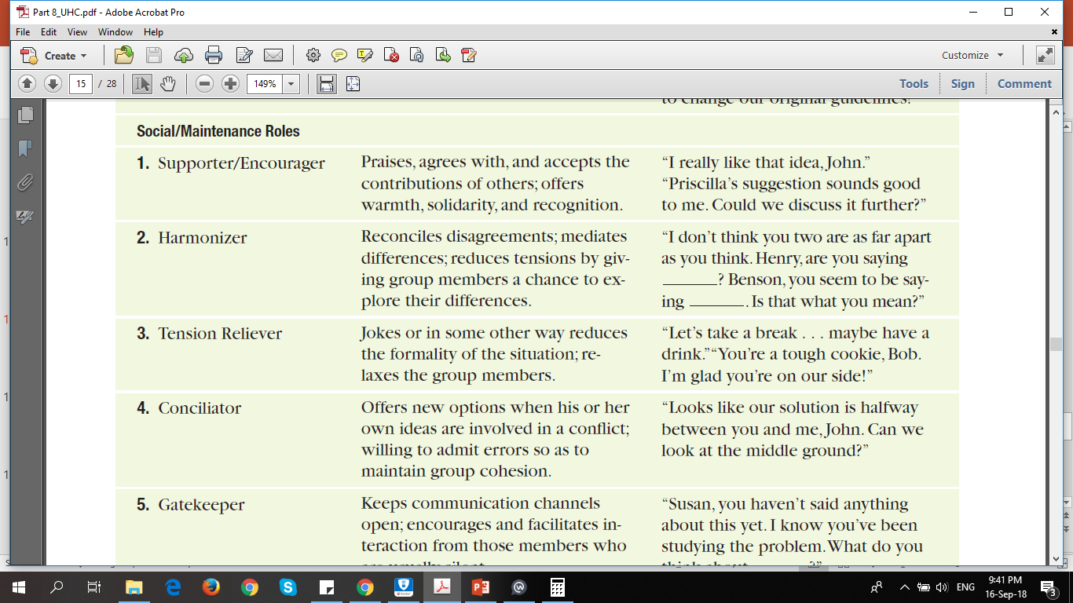

Slide 12
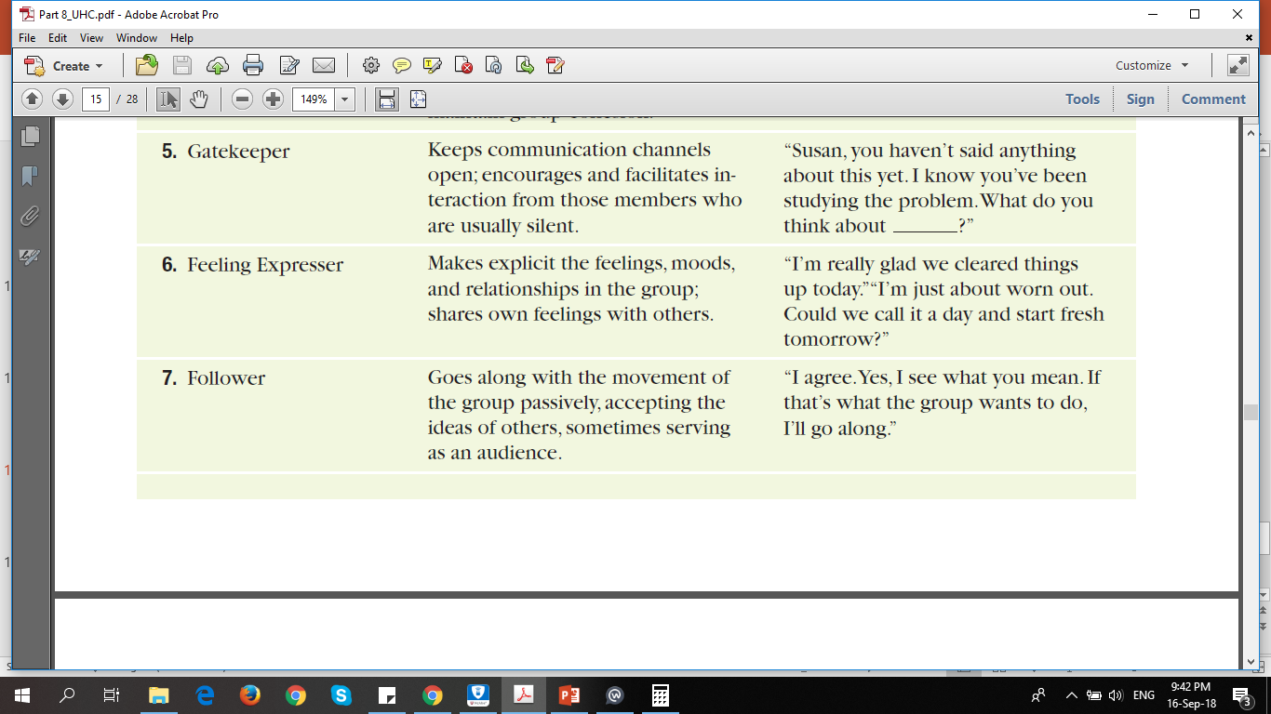

Slide 13
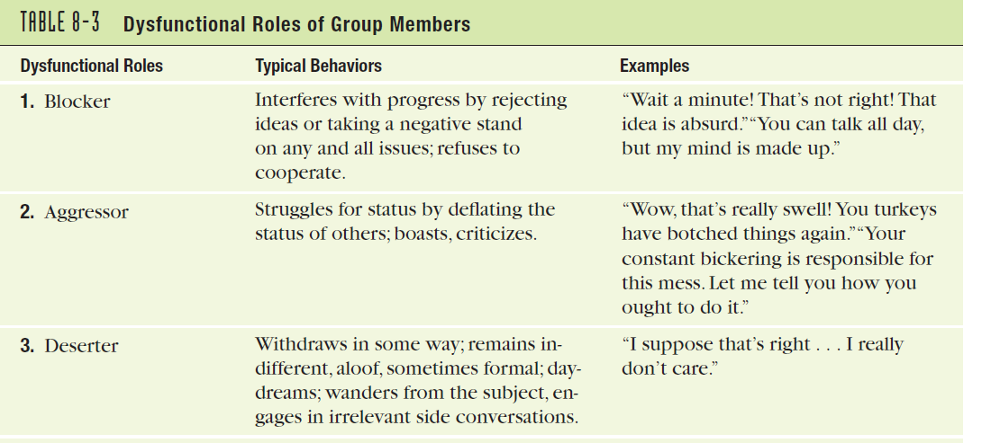

Slide 14
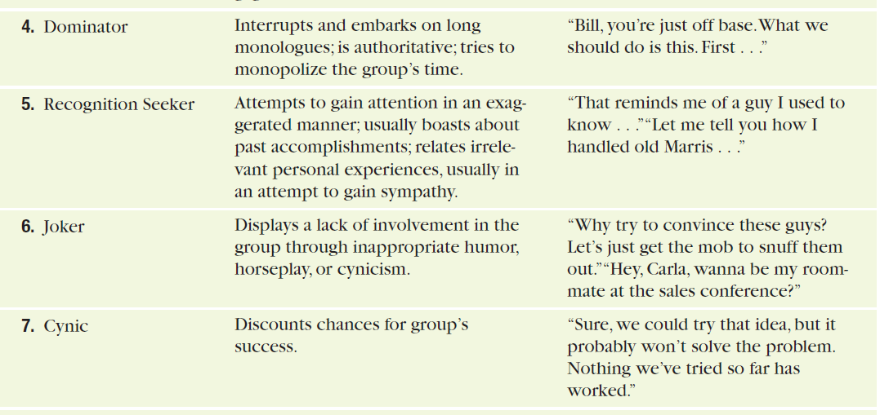

Slide 15
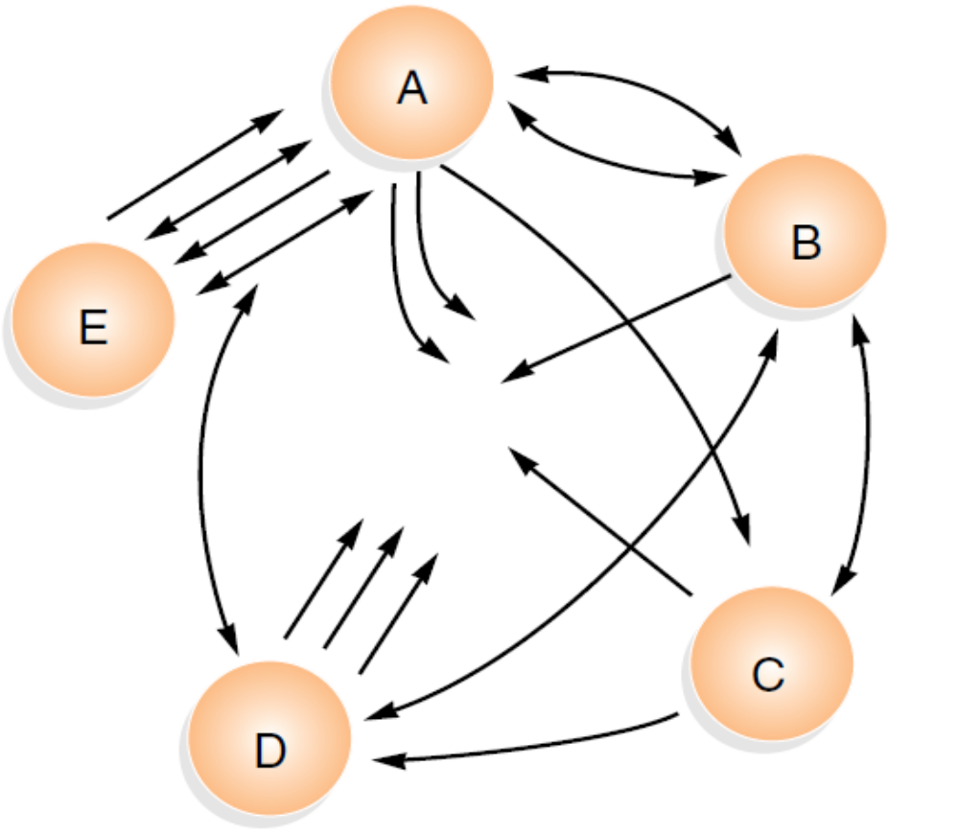
Patterns of Interaction
SOCIOGRAM

Slide 16
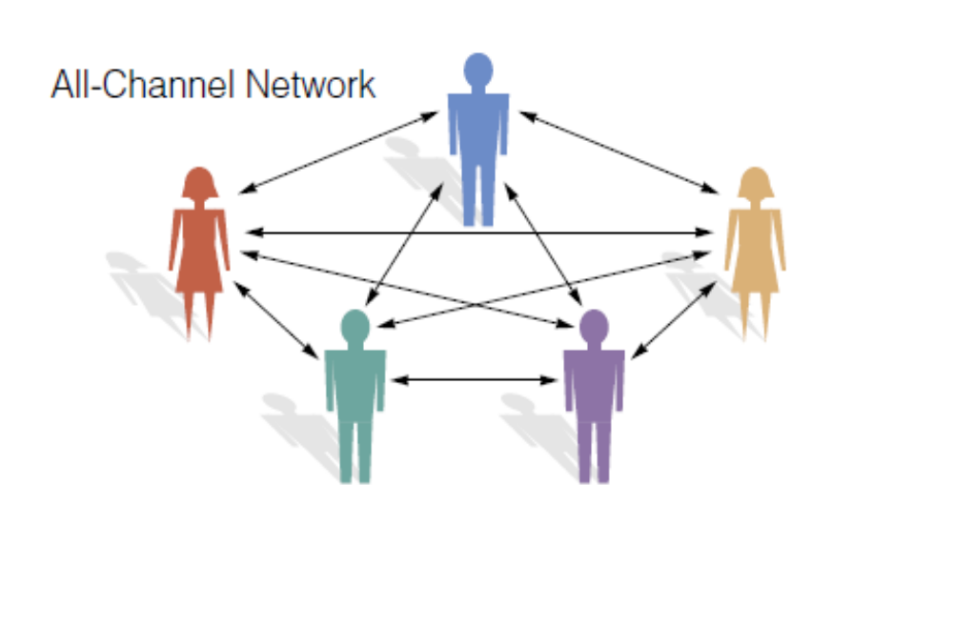

Slide 17
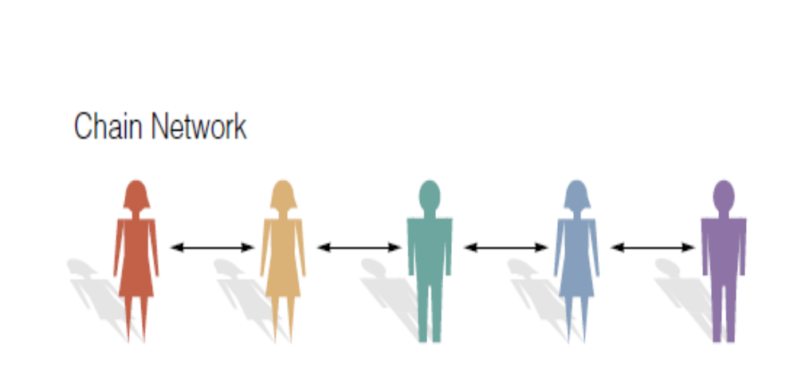

Slide 18
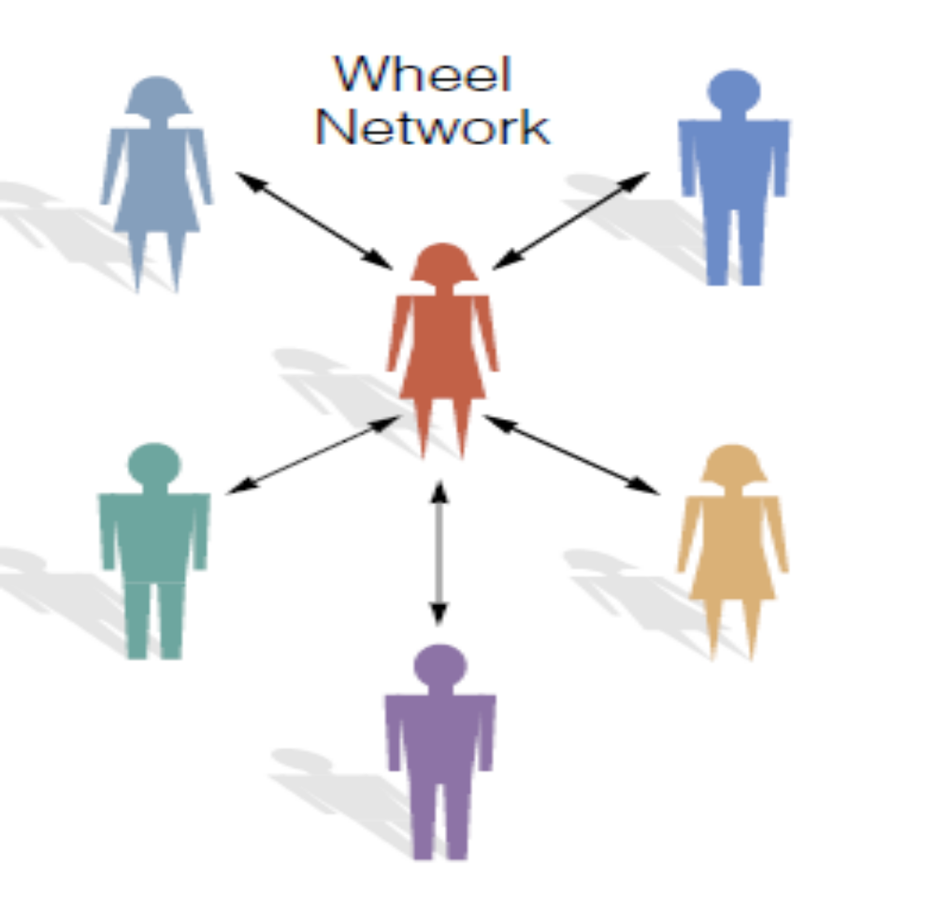

Slide 19
Decision-Making Methods
Another way to classify groups is according to the approach they use to make decisions.There are several approaches a group can use to make decisions. We’ll look at each of them now, examining their advantages and disadvantages ²⁴

Slide 20
CONSENSUS Consensus occurs when all members of a group support a decision. The advantages of consensus are obvious: Full participation can increase the quality of the decision as well as the commitment of the members to support it.Consensus is especially important in decisions on critical or complex matters;
in such cases, methods using less input can diminish the quality of or enthusiasm
for a decision. Despite its advantages, consensus also has its disadvantages.
It takes a great deal of time, which makes it unsuitable for emergencies. In addition,
it is often very frustrating: Emotions can run high on important matters,
and patience in the face of such pressures is difficult. Because of the need to
deal with these emotional pressures, consensus calls for more communication skill
than do other decision-making approaches. As with many things in life, consensus
has high rewards, which come at a proportionately high cost.

Slide 21
MAJORITY CONTROL
A naive belief of many people is that the democratic method of majority rule is always superior. This method does have its advantages in matters where the support of all members isn’t necessary, but in more important matters it is risky.
Remember that even if a 51 percent majority of the members favors
a plan,49 percent might still oppose it—hardly sweeping support for any decision that needs the support of all members in order to work.

Slide 22
EXPERT OPINION
Sometimes one group member will be defined as an expert and, as such, will be given the power to make decisions. This method can work well when that person’s judgment is truly superior. For example, if a group of friends is backpacking in the wilderness, and one becomes injured, it would probably be foolish to argue with the advice of a doctor in the group.

Slide 23
MINORITY CONTROL
Sometimes a few members of a group will decide matters. This approach works well with noncritical questions that would waste the whole group’s time. In the form of a committee, a minority of members also can study an issue in greater detail than can the entire group. When an issue is so important that
it needs the support of everyone, it's best at least to have the committee report its findings for the approval of all members.

Slide 24
AUTHORITY RULE
Authority rule is the approach most often used by autocratic leaders .Though it sounds dictatorial, there are times when such an approach has its advantages. This method is quick: There are cases when there simply isn’t time for a group to decide what to do. The approach is also perfectly acceptable with routine matters that don’t require discussion in order to gain approval. When overused, however, this approach causes problems.

Slide 25
Culture notwithstanding, the most effective approach in a given situation depends
on the circumstances:
 The type of decision Some decisions can best be made by an expert, whereas
others will benefit from involving the entire group.
 The importance of the decision If the decision is relatively unimportant,
it’s probably not worth involving all members of the group. By contrast, critical
decisions probably require the participation, and ideally the buy-in, of all
members.
 Time available If time is short, it may not be possible to assemble the entire
group for deliberations.27

Slide 26
Members of individualistic cultures view their primary responsibility as being to themselves,
whereas members of collectivistic societies feel loyalties and obligations to the groups
of which they are members: the family, the community, the organization they work for, and
their working teams. Members of individualistic societies gain most of their identity and self-esteem from their own accomplishments, whereas members of collectivistic societies are
identified with the groups to which they belong. Individualistic cultures are also characterized by self-reliance and competition, whereas collectivistic cultures are more attentive to and concerned with the opinions of significant others.33
Individualistic and collectivistic cultures have
very different approaches to communication.
For example, individualistic cultures are
relatively tolerant of conflicts, using a direct,
solution-oriented approach. By contrast, members
of collectivistic cultures are less direct.34

Slide 27
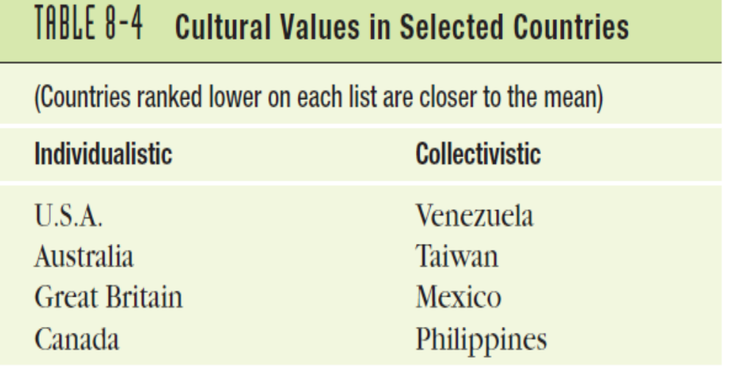

Slide 28
Power Distance
Some cultures accept differences in power and
status, whereas others accept them grudgingly, if at all. Most members of U.S.
and Canadian cultures are firm believers in the principle of equality, which means
that the notion that some people are entitled to greater power or privilege
doesn’t come easily. In other cultures, inequality is accepted as a fact of life.35
Power distance refers to the degree to which members are willing to accept difference in power and status between members of a group. In a culture with a high power distance, group members might willingly subordinate themselves to
a leader—especially one whose title comes from socially accepted sources such as age, experience, training,or status.

Slide 29
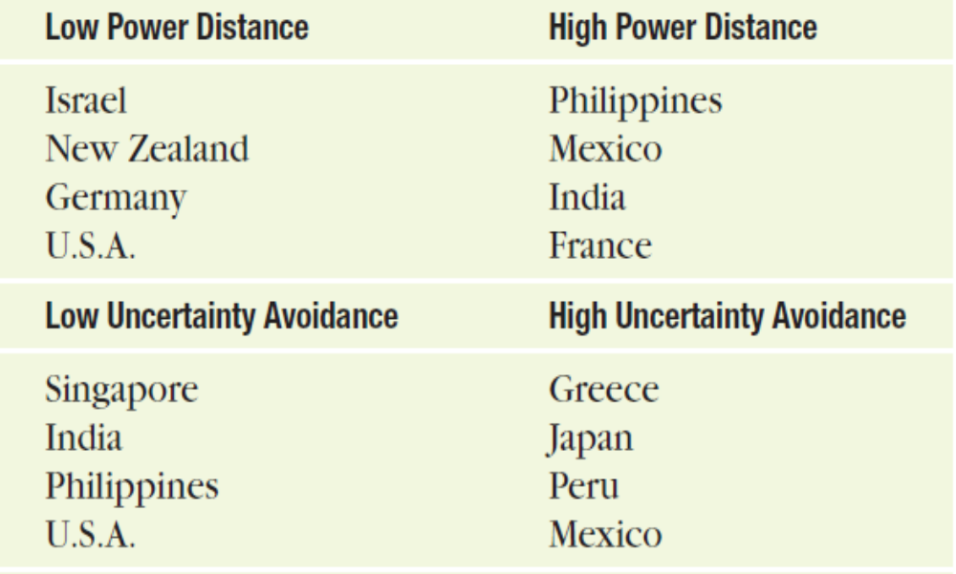

Slide 30
Uncertainty Avoidance
Some cultures accept—and even welcome—risk, uncertainty, and change.36
Others,characterized by uncertainty avoidance, are uncomfortable with these
unavoidable trends. Instead,they favor stability and tradition. Geography offers no
clue to a culture’s tolerance of uncertainty. Countries whose members tend to
avoid surprises include Greece, Portugal,Turkey,Mexico, and Israel. Among those who are more comfortable with change are Denmark, Hong Kong, Ireland, and India.

Slide 31
Task versus Social Orientation
(Japan,Austria,
Switzerland, and Mexico are examples) focus heavily on getting the job done. By
contrast,groups in societies with a high degree of social orientation (including all
the Scandinavian countries, Chile, Portugal, and Thailand) are more likely to be
concerned about the feelings of members and their smooth functioning as a team.
When compared to other countries,the United States falls slightly toward the taskoriented
end of the spectrum, and Canada is almost exactly in the middle, balanced
between task and social concerns.37

Slide 32
Short- versus Long-Term Orientation
Members of some cultures look for quick payoffs, whereas members of other cultures
are willing to defer gratification in pursuit of long-range goals. The willingness
to work hard today for a future payoff is especially common in East Asian cultures,
including China,Japan,and South Korea. Western industrialized cultures are
much more focused on short-term results.

Slide 33
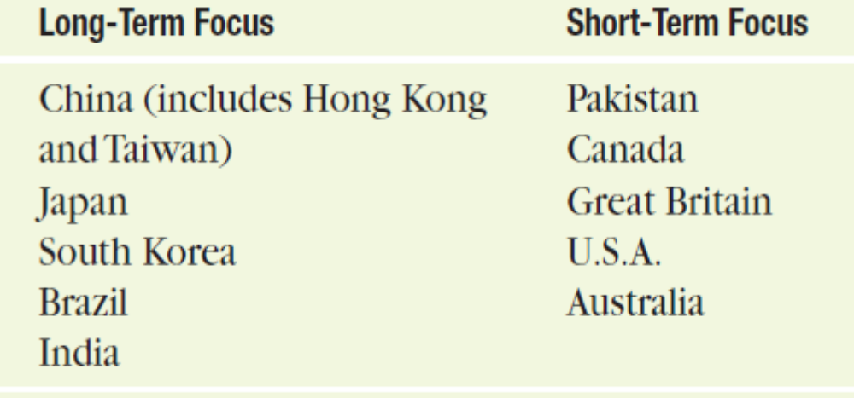

Slide 34
Groups don’t work in a vacuum. The culture in
which they work influences the way members communicate
with one another. The chapter examined
five ways in which culture influences interaction: individualism versus collectivism, power distance, uncertainty avoidance, task versus social orientation, and
short- versus long-term goals.

